Slide 1

Reading Comprehension

Slide 2
Aims
Understand what inference and deduction are.
Know why inference and deduction are important skills.
Know how to help your children develop their inference and deduction skills.

Slide 3
Decoding the text
Retrieval of information is often the starting point for discussing a text. This means asking your child to pick information out of the text that they have just read e.g.
What was the character’s name?
What did they eat for dinner?
What colour was the car?

Slide 4
Inference and Deduction
Inference: is an interpretation that goes beyond the literal information given.
Deduction: is an understanding based on the evidence given in the text.
e.g. The police find a body with a knife sticking out of it.
We could infer that someone didn’t like that person.
We can deduce that the person has probably been murdered because it has a knife sticking out of it.

Slide 5
Using text to infer and deduce
In order to be able to infer and deduce from a text children need to be able to decode confidently. The text should not be too hard for them otherwise they will focus all their energies on trying to get a literal meaning and will miss the subtle clues given.

Slide 6
Why are Inference and Deduction Important?
They make reading more pleasurable!
As adults we naturally make inferences and deductions each time we read a book.
We want to read on! We do not become frustrated or reluctant to read because we can decode the text, and also read between the lines to deepen our understanding.

Slide 7
Suggestions for at home
When your child chooses a book, look at the cover together. Ask your child what they can infer from the front cover – what can you tell about the genre of book and what the characters/plot might be.
Encourage your child to relate to the characters. E.g. How do you think the character is feeling at this point? Why might they be feeling this way? How would you feel if you were in their situation?

Slide 8
Illustrations
Picture books are suitable for children of all ages and can really help to develop inference and deduction skills.
Encourage your child to answer questions about illustrations.

Slide 9
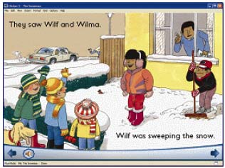

1
What is this person doing? Why?
Why does this man look cross?
What do you think he is saying?
Does this person like sweeping the snow? What makes you think that?

Slide 10
Films
Film clips can be a good tool for practising inference skills
What can you infer about the characters in each of the stills?
You can do this at home simply by pausing films and asking your children questions about them.

Slide 11
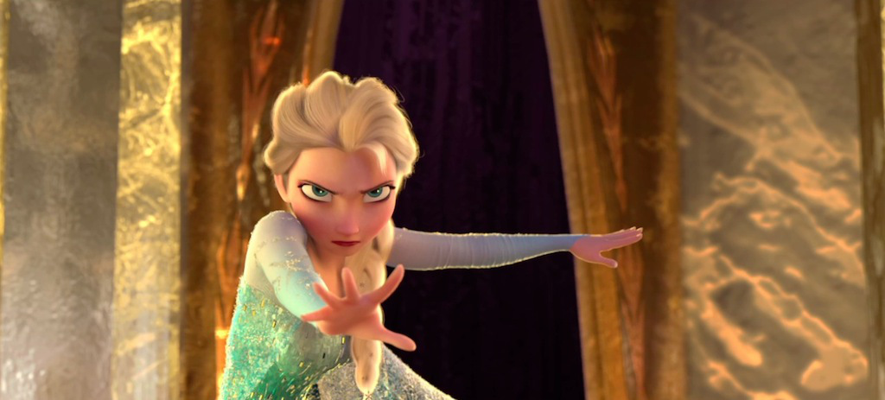
How do you think she is feeling at this point in time? How do you know?
What do you think she will do next?

Slide 12
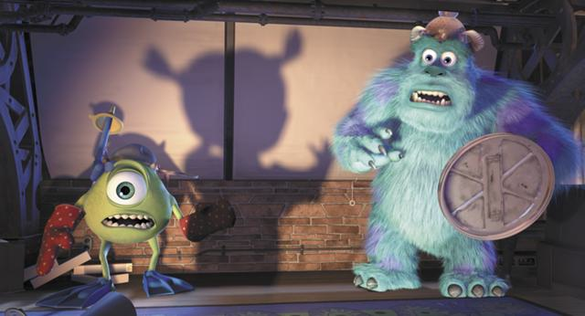
Why do you think Sully and Mike are scared?
What are they holding and why are they holding these objects?

Slide 13

Where do you think they are?
How are the others reacting to Gru? What clues tell you?

Slide 14
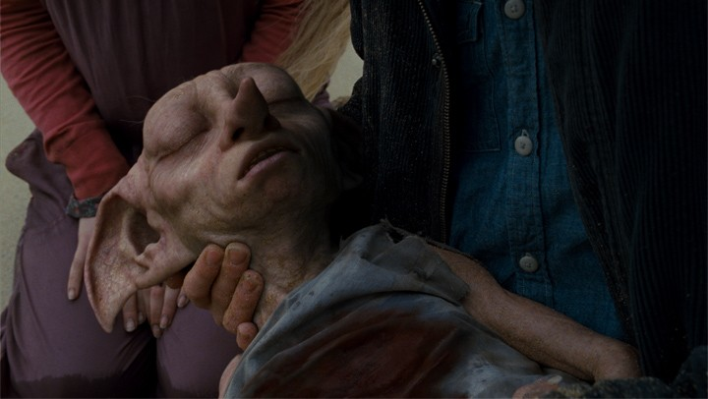
What can you tell about the characters who are not in the shot?
What type of genre is this film? How can you tell just from this shot?

Slide 15
Questioning
Asking questions about the text your child is reading encourages them to think more deeply about it.
Eventually they begin to ask themselves questions about what they have read.

Slide 16
Example questions
What words give you that impression? Why?
How do you feel about………? Why?
Can you explain why………….?
At the end of the story the main character is feeling ……. Does this surprise you?
What does this tell you about what ……….was thinking?
Do you think this is true/untrue? Why do you think this?
What do you think the ………. is thinking? If it were you what would you do?

Slide 17
Reading Journals
The Reading Journals are a way of letting your child know how they are getting on with their reading.
They also allow easy communication with your child’s teacher regarding the progression of their skills at home.
You need to be reading, (with your child at least three times a week at home (all the way up to Year 6) although ideally every day.

Slide 18
Variety is the spice of life!
Encourage your child to read a range of texts. This will allow them to develop their inference and deduction skills in both fiction and non-fiction.
You could link non-fiction reading to your child’s topics at school e.g. the Tudors or Space.
You could also read extracts from a children’s newspaper such as First News or the Newsround website.

Slide 19
Thank you for your attention
For more information please speak to your child’s class teacher or Mrs Haines (English Subject Leader).

