Slide 1
Read Write Inc. Phonics
Parents’ Meeting
Fred Talk
Notes:
Approximately 20 minutes is needed for this session.
Notes are provided to help you lead the presentation.
Notes in italics are for your attention only.
This bitesize parent session is best used alongside a demo of a Fred game in action with a group of children. Alternatively, you could play a Fred Game with the parents.
Provide copies of ‘Reading at Home Booklet 1’ from Oxford Owl and Fred Games list for each parent.

Slide 2
Reading changes everything
Teach a child to read and keep that child reading and we will change everything.
And I mean everything.
Jeanette Winterson
Notes:
Read quote.

Slide 3
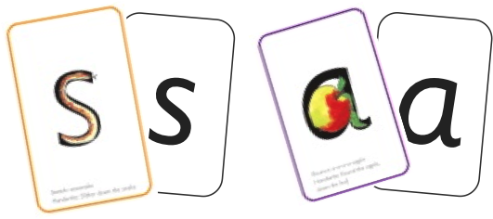

Sounds + blending = reading
+
Notes:
Today I want to help you understand how your child is learning to read words in Read Write Inc. Phonics by blending sounds together:
Alongside teaching children sounds, we teach them to blend sounds to read words e.g. s-a-t, sat.
We use Fred Talk to help children read.

Slide 4
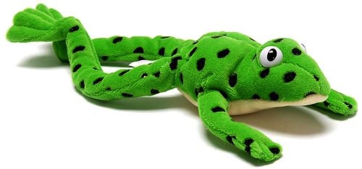
Fred
Notes:
Let me introduce you to Fred.
Fred can only speak in sounds. He says d-o-g, h-a-t etc.
Speaking like Fred helps children to understand that words are made up of sounds.
Fred helps children practise blending sounds together because he needs the children to say the words for him. Fred says d-o-g, children tell him the word is dog.
This is how we quickly teach all of our children to blend.

Slide 5
Speed Sounds Set 1
Notes:
Remember that:
- Children need to know sounds – not letter names – to read words.
- We pronounce the sounds clearly, using pure sounds (‘m’ not’ muh’, ’s’ not ‘suh’, etc.) so that your child will be able to blend the sounds together to make words more easily.

Slide 6
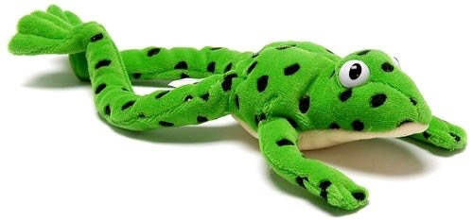
Fred Talk routine
Say the word in sounds as Fred e.g. c-a-t.
Ask your child to repeat. Can they ‘jump-in’ with the whole word?
Say the word in sounds followed by the whole word e.g. c-a-t, cat
Ask your child to repeat
Notes:
Fred Talk follows a consistent routine:
Say the word in sounds as Fred e.g. c-a-t. Ask children to repeat. Pause to allow children to ‘jump-in’ with the whole word.
Say the word in sounds followed by the whole word e.g. c-a-t, cat. Ask children to repeat.

Slide 7
Fred games and Fred talk throughout the day
l
-u
?
Shall we have some
What would you like to
Let’s put on your
-ch
-n
-ay
-l
p
?
-oa
-t
c
.
Notes:
Try to use Fred Talk throughout the day at home to help your child practise blending sounds together.
Fred Talk words at the end of the sentence and keep the words short and simple.
With the person next to you, have a practise of the three sentences on the screen.
Remember to Fred Talk the last word of the sentence.
You can also play Fred Games with your child at home. I will show you one of these in action in a moment,

Slide 8

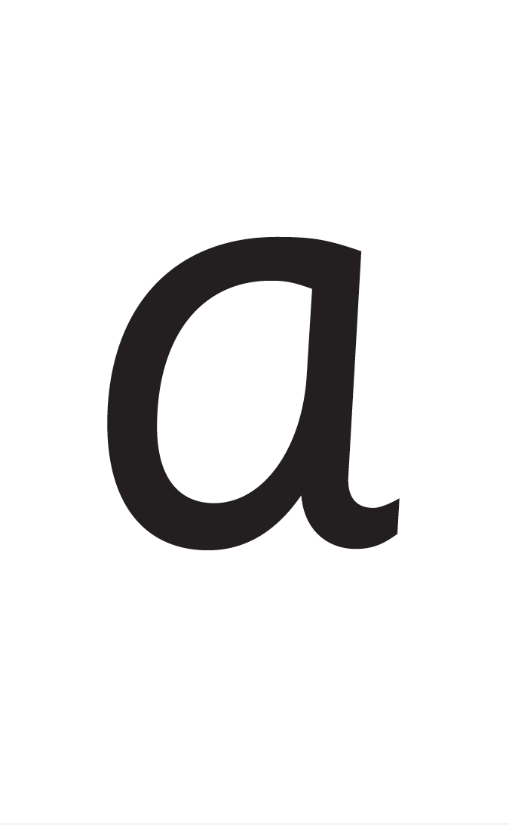


Reading with Fred Talk
Notes:
We teach children to read words using Fred Talk to blend together the sounds they know e.g. m-a-t, mat.
We say ‘Fred Talk, read the word’.

Slide 9
What can I do?
1. Speak like Fred throughout the day
2. Play Fred games
3. Use ‘Fred Talk, read the word’ to read words
Notes:
Give handout of Fred Games and Reading at Home Booklet 1’ to parents.
Show how to use the Sound Blending Books to read words ready for when children start to take these home.
You can purchase Set 1 flashcards or My Reading and Writing Kit ages 5-7 more sounds and blending to support your child with blending at home.

Slide 10
Online resources available
Ruth Miskin Parents’ Page:
http://www.ruthmiskin.com/en/parents/
Ruth Miskin Facebook:
https://www.facebook.com/miskin.education
Free e-books for home reading:
http://www.oxfordowl.co.uk/Reading/

Slide 11
Fred games – in action
Notes:
Demonstrate teaching a Fred Game to a group of children/ parents as children using the Fred Games list available on the School Portal.

Slide 12

Free Video Tutorials (ruthmiskin.com)
Notes:
Watch these video tutorials on the Ruth Miskin website to help your child to practise sound blending and reading words with Fred Talk at home:
Sound-blending
Blending sound books

Slide 13
Reading changes everything
Teach a child to read and keep that child reading and we will change everything.
And I mean everything.
Jeanette Winterson
Notes:
Remember that all parents have the power to change outcomes for their children.

Slide 14
Any other questions
Q&A

